Slide 1

SALES DASHBOARD – SUPER STORE
Title: Sales Performance Analysis using Power BI
Subtitle: A Data-Driven Approach to Business Insights
Presented by: KALIMULLAH . K

Slide 2
INTRODUCTION :
Power BI is a powerful tool for data visualization and business intelligence, enabling users to transform raw data into meaningful insights.
This project focuses on analyzing sales performance to gain actionable insights that drive strategic decisions, improve operational efficiency, and enhance customer satisfaction.

Slide 3
OBJECTIVE :
Visualize region-wise, product-wise, and category-wise performance to identify strengths and weaknesses.
Analyze historical sales data to understand trends and patterns across time, regions, and customer segments.
Analyze revenue by region, product, and month performance to identify strengths and weaknesses.
Support data-driven decision-making for marketing, inventory, and sales strategy optimization.

Slide 4
PROBLEM STATEMENT
Businesses face challenges in tracking performance across multiple dimensions due to fragmented data sources and static reporting.
Manual reports lack interactivity, scalability, and real-time insights, making it difficult to respond quickly to market changes.
There is a pressing need for a centralized, dynamic dashboard that monitors KPIs, highlights anomalies, and supports drill-down analysis for deeper understanding.

Slide 5
DATASET DESCRIPTION :
Source: Sample Superstore Dataset / Sales Dataset from Kaggle Data Fields Include:
Order ID, Product Name, Category, Sub-Category
Sales, Quantity, Discount, Profit
Customer Name, Region, Segment
Order Date, Ship Date, Shipping Mode
The dataset spans multiple years and includes transactional details across various geographies and customer types, providing a rich foundation for analysis.

Slide 6
TOOLS & TECHNOLOGIES :
Power BI: Used for building interactive dashboards and visualizations.
Excel/CSV: Primary data source for importing and preprocessing.
DAX (Data Analysis Expressions): Used to create calculated columns, measures, and KPIs for deeper insights.
Power Query Editor: Applied for data transformation, filtering, and shaping before modeling.

Slide 7
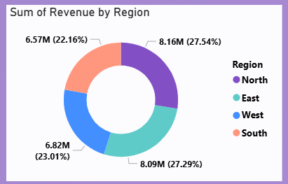
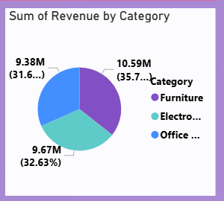
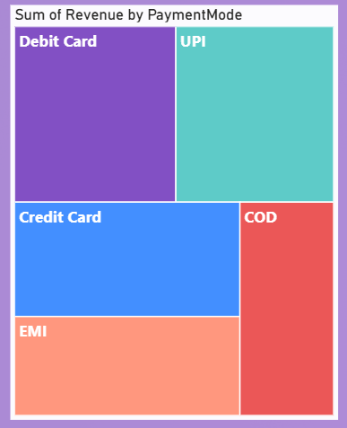
VISUALIZATION :
Sum of Revenue by Region
Sum of Revenue by Category
KPIs

Slide 8
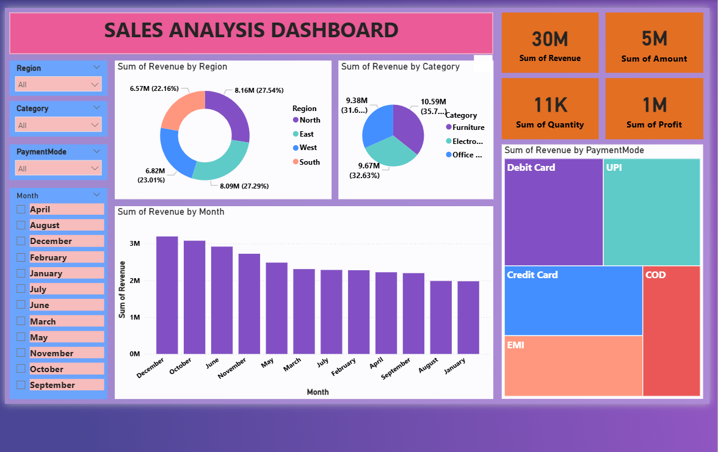
OUTPUT :

Slide 9
CONCLUSION :
Power BI enables businesses to make data-driven decisions by providing real-time, interactive insights.
This dashboard offers a clear, multi-dimensional view of sales performance, helping stakeholders identify growth opportunities, optimize pricing strategies, and improve customer targeting.
It transforms static data into strategic intelligence, empowering teams across departments.

Slide 10
THANK YOU

